Slide 1


Spare parts
GIT El Salvador

Slide 2
Background
Is needed to record spare parts
Automation of Suspend/Resume depending on spare parts
Approve/reject spare parts from dispatch

Slide 3
Mobile
Mateline

Slide 4
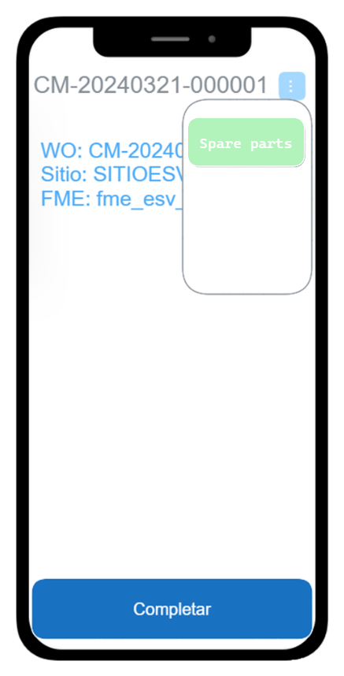
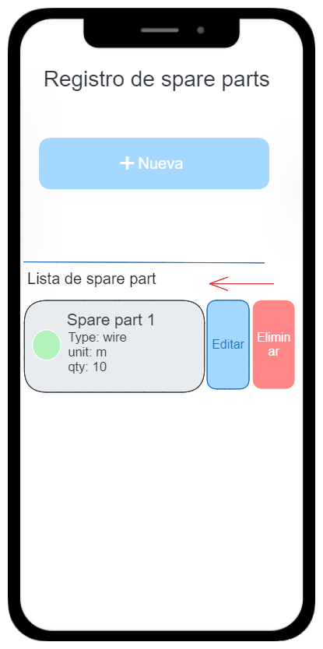
Main spare parts page
Register new spare
Delete spare
Edit spare

Slide 5
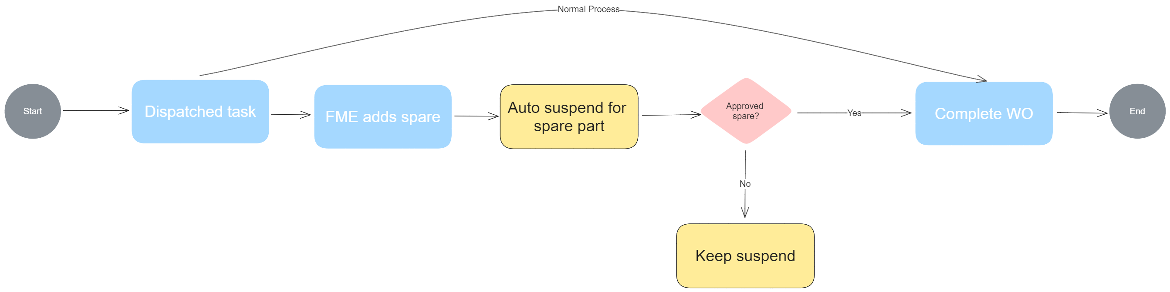
Auto Pause/Resume feature

Slide 6
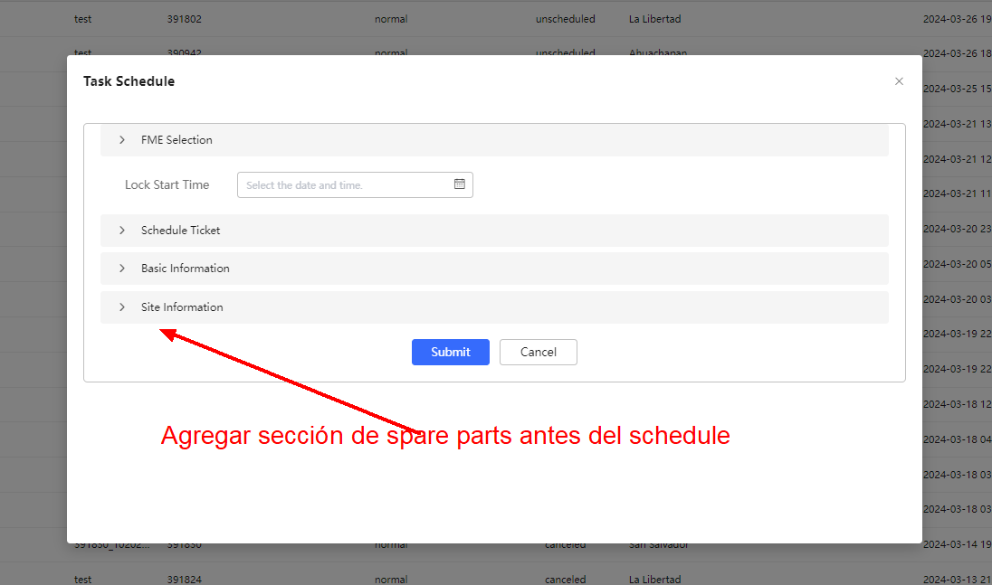
Auto Pause/Resume feature
Dispatch center can add spare parts in the Schedule modal
- Pause when add new spare
- Resume when approve all

Slide 7
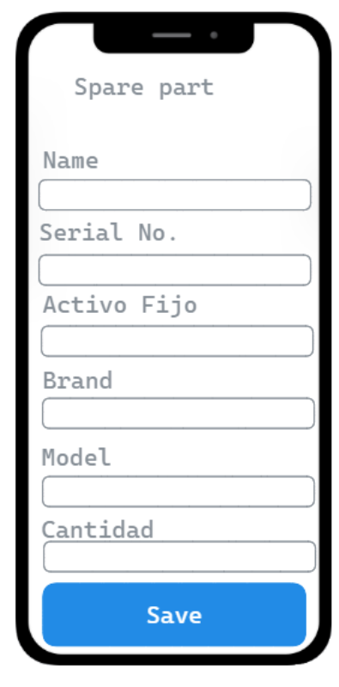
Spare part form
FME must fill the spare part form and submit
Submit

Slide 8
PC page configuration

Slide 9
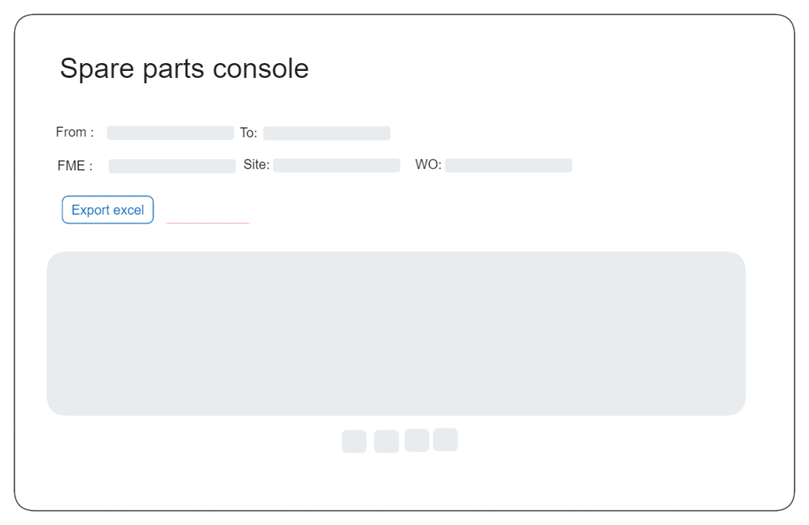
Spare part general console
After work order completion web users can:
++Export Excel info

Slide 10
Spare part support group console
Support groups can modify spare parts:
++Export Excel info

Slide 11
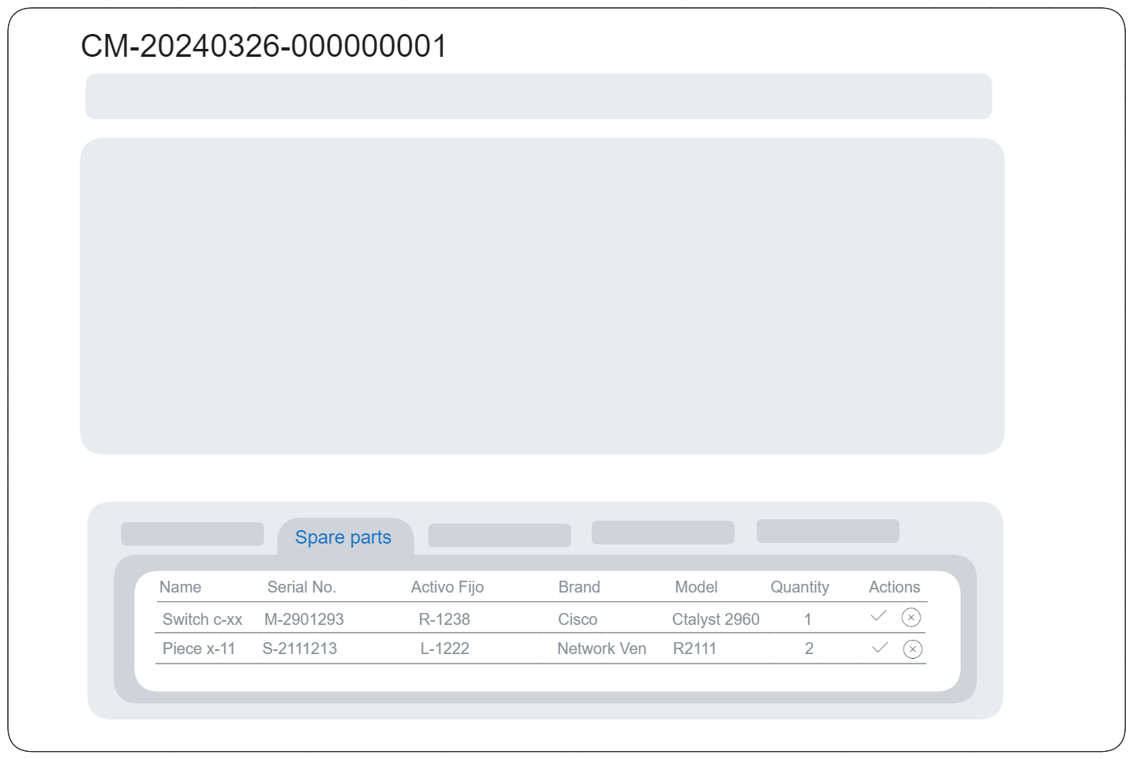
Spare part detail
Each Work order Will contain the spare part info
++ Export Excel feature
Submit

Slide 12
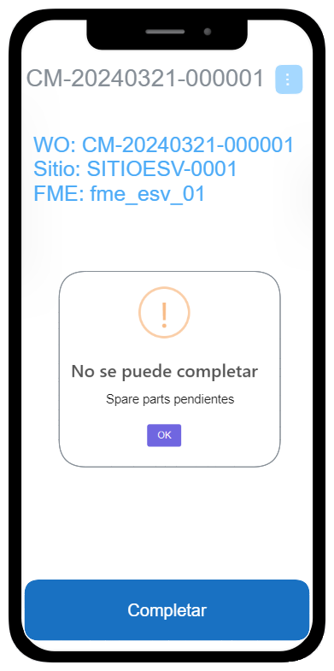
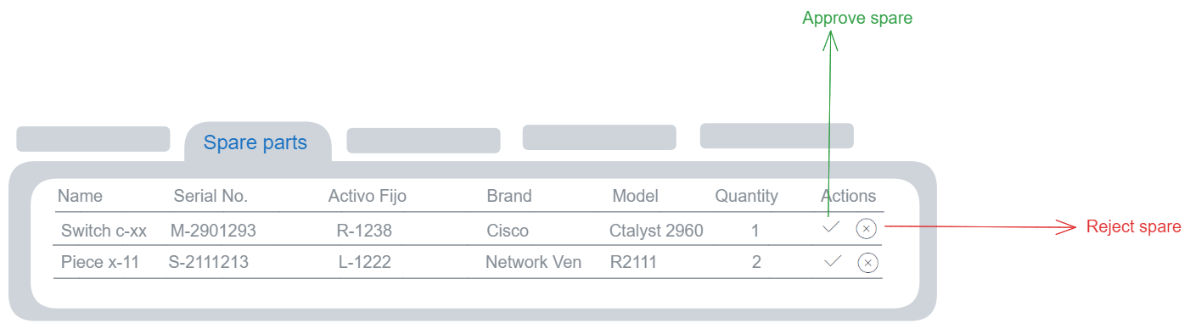
Spare part approve/reject
Approval people can approve or reject
spare parts

Slide 13
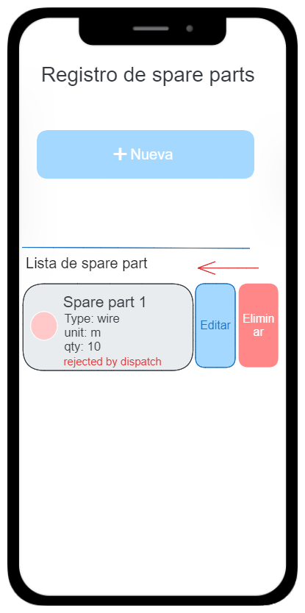
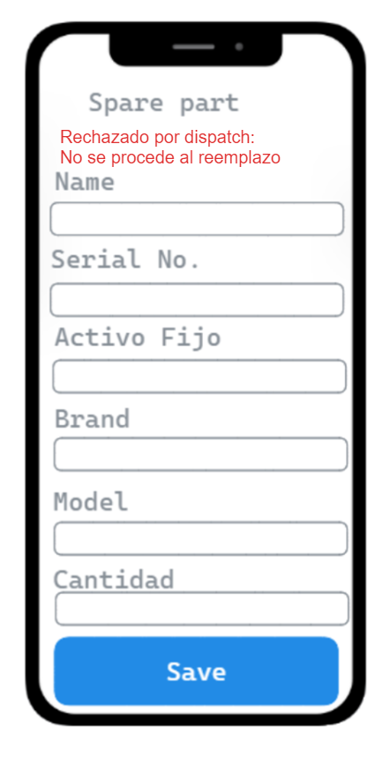
Spare part reject
FME must modify the spare part
depending on the approval
If there are not approved spare parts
can’t complete task
Submit

Slide 14
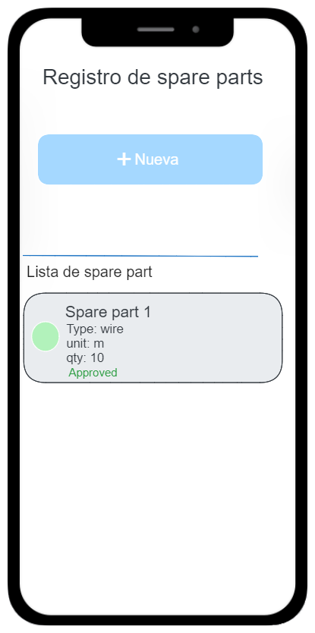
Spare part approve
FME can see if the spare is approved
When all spare are approved, complete phase is unlocked
The ticket is resumed when all spare all approved

Slide 15
WFM integration
A button to go to spare parts form will be available before complete the work order

Slide 16
Work plan
Task | Duration
Mobile development | 15
Auto Pause/resume feature | 4
Console development | 5
WFM mateline page integration feature | 1
Testing | 1
Deployment (field usage monitor) | 2
Total | 28 working days

Slide 17



Copyright©2014 Huawei Technologies Co., Ltd. All Rights Reserved.
The information in this document may contain predictive statements including, without limitation, statements regarding the future financial and operating results, future product portfolio, new technology, etc. There are a number of factors that could cause actual results and developments to differ materially from those expressed or implied in the predictive statements. Therefore, such information is provided for reference purpose only and constitutes neither an offer nor an acceptance. Huawei may change the information at any time without notice.

